Slide 1
Android Fundamentals
Lecture 3
Tom Karni, Itsik Avidan

Slide 2
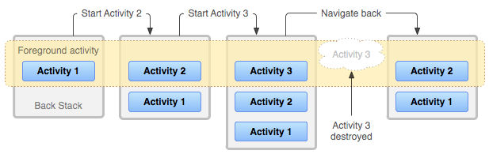
Application Task

Slide 3
Application task – launch modes
Manifest : <activity> android:launchMode | Intent Flags
standard
singleTop
singleTask | FLAG_ACTIVITY_NEW_TASK
singleInstance | FLAG_ACTIVITY_SINGLE_TOP
 | FLAG_ACTIVITY_CLEAR_TOP
The launched Activity will be resumed through the onNewIntent() method

Slide 4
Intent & Intent Filters
The Intent message is responsible for activating Activities, Services & Broadcast Receiver using the relevant method.
The Android OS is responsible to find the appropriate Activity, Service, Broadcast Receiver to respond to the intent.

Slide 5
Intent
The Intent Object contains information for the component that receives the intent & for the Android OS
Component name
Action
Data ( URI & MIME )
Category
Extra
Flags
Explicit Intent
Implicit Intent
Notes:
URI – Uniform Resource Identifier

Slide 6
Intent Filters
Describes a capability of the component – a set of intents that the component is willing to receive
Component can have more than one Intent filter – each job will be represented by a filter
Generally not set up in the Java code but in the AndroidManifest.xml file , except Broadcast Receiver that can be registered dynamically by calling Context.registerReciver()

Slide 7
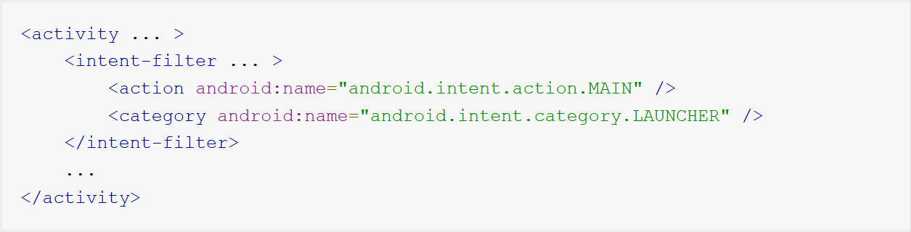
Task & Intent
Cause an Icon and label to be displayed in the application launcher
Creates a new task for the application, enables the user to return to it any time after it has been launched

Slide 8
Broadcast Receivers
Responding to a global event such as a ringing phone or an incoming text message
Application registers to receive Intent in one of the following
At runtime using the Context
On the Android-Manifest.xml file
If requires more than a trivial amount of code execution, it’s recommended that the code initiate a request to a Service

Slide 9
Process & Threads
Launching an Application >> new Linux process with a single thread
Changing the default behavior is available via the AndroidManifest.xml file

Slide 10
Process lifecycle
Process (application ) may be killed by the OS according to their “importance hierarchy”
Foreground process
Visible process
Service process
Background process
Empty process

Slide 11
Threads
All of the components runs on the same threads as default – the “UI thread”
If everything is happening in the UI thread, performing long operations such as network access or database queries will block the whole UI
Do not block the UI thread
Do not access the Android UI toolkit from outside the UI thread

Slide 12
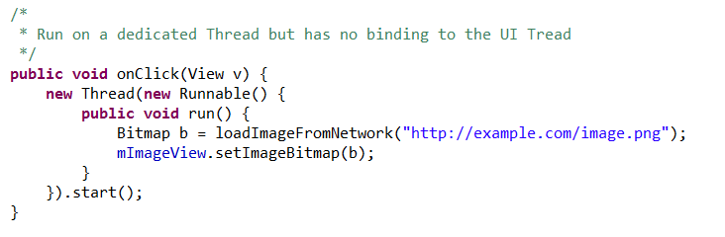
Threads

Slide 13
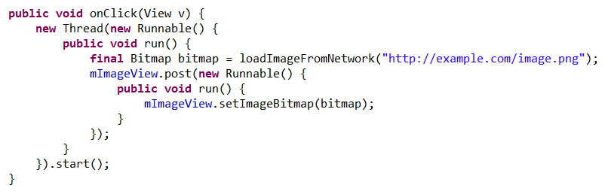
Threads
Worker Threads
Activity.runOnUiThread(Runnable)
View.post(Runnable)
View.postDelayed(Runnable,long)

Slide 14
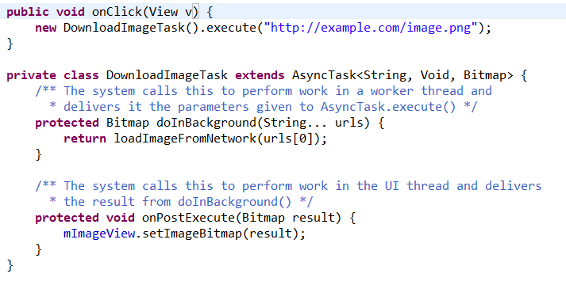
Threads
Async Tasks

Slide 15
User Interface
Tom Karni, Itsik Avidan

Slide 16
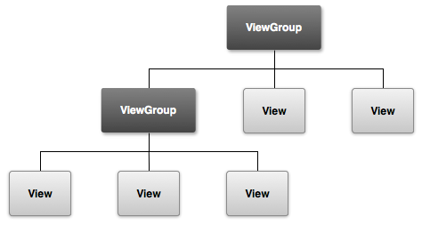
Intro
View – (Object) draws something on the screen
ViewGroup – (Object) holds other View and ViewGroup
Can be declared in code and be build at runtime on declared in a .XML file precompilation

Slide 17




Layouts
LinearLayout
RelativeLayout
AbsolutelLayout
FrameLayout
TableLayout
ListView
GridView

Slide 18
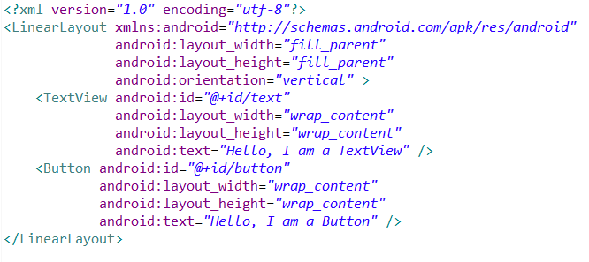
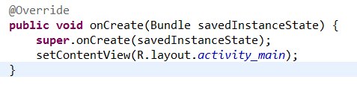
Layout definition and binding
Write the .XML for the layout under the ../res/layout/ directory
Load the layout resource at runtime using its ID

Slide 19
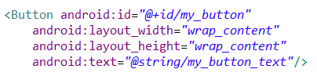
Layout attributes
android:id – to uniquely identify the View within the tree
@ : relative path
+ : indication for a new resource declaration

Slide 20
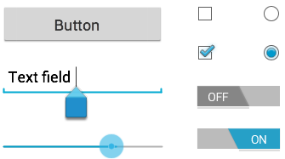
Input controls
Android provides a wide veracity of UI controls (Widgets)
Adding the widgets can be done using the xml layout or within the Activity code.

Slide 21
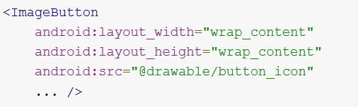
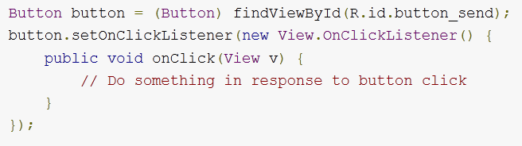
Buttons
Consists of text and/or icon
The “onClick” event can be declared
On the XML – android:onClick
On the code – OnClickListener
Can be styled

Slide 22
Text Fields
Allows the user to type text into the application
android:inputType param - Can have different input types – numbers, data, passwords, email etc.
android:imeOption – specify an action to be made when users have completed their input
onEditorActionListeneer – listen for the specific action event

Slide 23
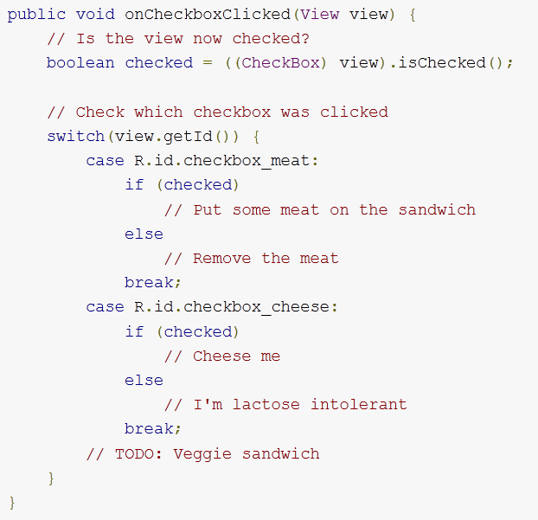
Checkboxes
Allow the user to select one or more options from a set
For each CheckBox , a onClick listener must be defined
The definition can be for all CheckBoxes in the view with differend handling

Slide 24
Toggle
Allows the user to change a setting between two states
In addition to onClickListener there is the OnCheckedChangeListener
Android 4.0 – introduces another kind of Toggle “Switch” that allows a slider control

Slide 25
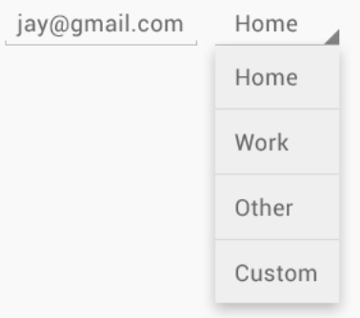
Spinner
Provide a quick way to select one value from a set
In the default state, a spinner shows its currently selected value
The Spinner can be populated from any source, but must be provided using the SpinnerAdapter

Slide 26
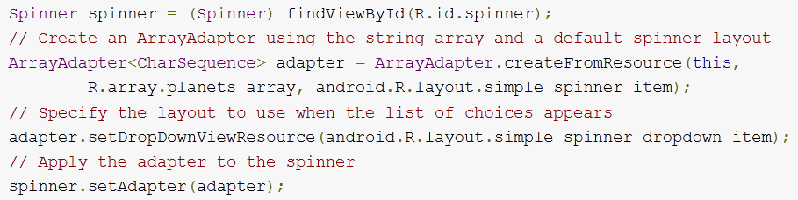
Spinner

Slide 27
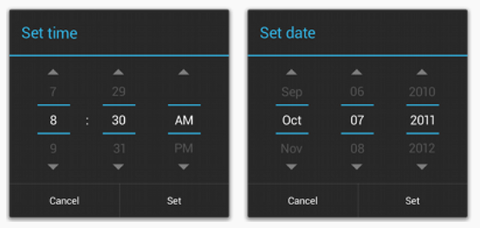
Picker
Android provides controls for the user to pick a time or pick a date as ready-to-use dialogs
Using these pickers helps ensure that your users can pick a time or date that is valid, formatted correctly, and adjusted to the user's locale

Slide 28
Input Events
For each View component there are several useful UI public methods
These methods are called by the Android FW when the respective action occurs on the Object
Developer can extend each view and implement the behavior of each event – bad practice !
The developer can use View’s nested interfaces with callbacks – Event Listeners

Slide 29
Event Listeners
An interface in the View class that contains a single callback method
These methods will be called by the Android FW when the View to which the listener has been registered is triggered by user interaction with the item in the UI
onClickListener , onFoucusChange() , onKey() , onCreateContextMenu() etc.

Slide 30
References
Android developers [http://www.android.com/develop] [http://developer.android.com/guide/components/index.html]
W.Frank Ableson, Robi Sen, Chris King. “Android in Action, 2nd edition”, 2011.
Google I/O 2010, The world of ListView [http://www.youtube.com/watch?v=wDBM6wVEO70]

